Slide 1
The Roots of Progressivism
Chapter 8 Section 1

Slide 2
Who Were the Progressives?
Progressivism was partly a reaction against laissez-faire economics and its emphasis on an unregulated market
Progressives general believed that industrialization and urbanization had created many social problems
Most agreed that government should take a more active role in solving society’s problems but at the same time they doubted that the government could fix it
They believed that the government had to be fixed before it could be used to fix other problems

Slide 3
Progressives cont…
One reason progressives thought they could improves society was their strong faith in science and technology
Science at this time had produced the lightbulb, telephone and automobile, skyscrapers and railroads
Science and technology had helped people, so progressives thought that by using scientific principles could also help fix the problems with society

Slide 4
Muckrakers
The first people to write about progressive ideas were a group of crusading journalists who investigated social conditions and political corruption
These journalists were called Muckrakers
They would only dig up the filth and dirt about companies and businesses and ignore everything else.
Muckrakers eventually uncovered corruption in many areas exposing unfair practices of large corporations.

Slide 5
Making Government Efficient
A group of progressives that focused on making the government more efficient created a movement of Efficiency Progressivism
This group believed that cities should be run by either a city manager or commissioner
These guys supported two proposals,
First, a commission plan- divide city governments into several departments, each one under an expert commissioner’s control
Second, a council-manager system. The city council would hire a city manager to run the city instead of the mayor
*Either way, an elected EXPERT plays an important role in managing the city

Slide 6
Scientific Management
Frederick W. Taylor published a book on theories of business efficiency called The Principles of Scientific Management
It described how a company could increase efficiency by manageeing time, breaking tasks down into small parts, and using standardized tools.
He argued that by managing business this way he would get the most out of productivity and he would be able to provide more job opportunities to unskilled workers.

Slide 7
Democratic Reforms
Another group of progressives focused on making the political system more democratic and more responsive to citizens.
Robert M. La Follette led Wisonsin to accomplish this progressive reform
La Follette attacked the way political parties ran their conventions
Party bosses controlled the selection of convention delegates, which means they also controlled the nomination of candidates.
He pressured the state legislature to pass a law requiring parties to hold a direct primary- which ALL party members could vote for a candidate to run in the general election

Slide 8
Because Wisconsin had a lot of successes with changing democracy, they were labeled as the “laboratory of democracy”
Soon after that progressives pushed for three more reforms, the initiative, the referendum, and the recall.
Initiative- allowed citizens to introduce laws or regulations and REQUIRED the legislature to vote on it.
Referendum- allowed citizens to vote on proposed laws directly without going to legislature
Recall- gave voters an option to demand a special election to remove an elected official from office before his or her term had expired

Slide 9
Direct Election of Senators
Progressives also targeted the Senate
As originally written, the federal constitution directed each state legislature to elect two senators
Political machines and business interests often influence these elections
To counter Senate corruption, progressives called for direct election of senators by the states voters
This later became the 17th Amendment to the Constitution

Slide 10
Women’s Right To Vote-Suffrage
The suffrage movement got off to slow start
Some people threatened women and did not want them to have those rights
Later after the 14th and 15th Amendments were passed, Alice Paul stepped up and took lead of the movement for women’s suffrage
Alice Paul headed the National American Woman Suffrage Association (NAWSA), she used protests to force suffrage and confronted President Wilson about these issues.
After so many years fighting for it, the 19th Amendment went into effect

Slide 11
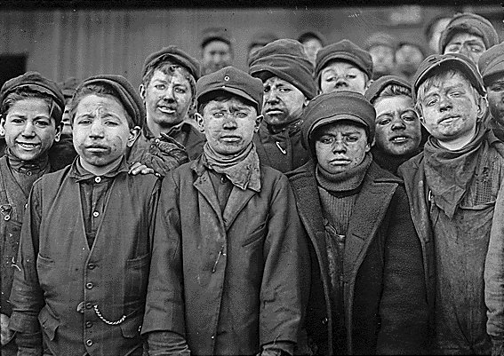
Child Labor
Progressives handled the most emotional issue, child labor
Children had always worked on family farms, but mines and factories presented more dangerous and unhealthy working conditions
Detailed evidence supported this issue when Muckraker John Spargo published a book about children in the work force
After many reports, states finally passed laws that set a minimum age for employment and established other limits on child labor such as hours.

Slide 12
Health and Safety Codes
Many adult workers also worked in difficult conditions. When workers died or got hurt on the job, they and their families received little or no compensation.
Progressives worked towards fixing this by pressuring states for workers compensation laws. These laws allowed for insurance funds for workers who became injured.

Slide 13
Triangle Shirtwaist Fire
March 25, 1911- fire broke bout on the top floors of the building
Young women struggled against locked doors to escape
Some women managed to get out using the fire escape, others died or jumped to their death from the 9th floor.
150/500 lost their lives
This tragedy led to the passing of building codes requiring fire escapes

Slide 14
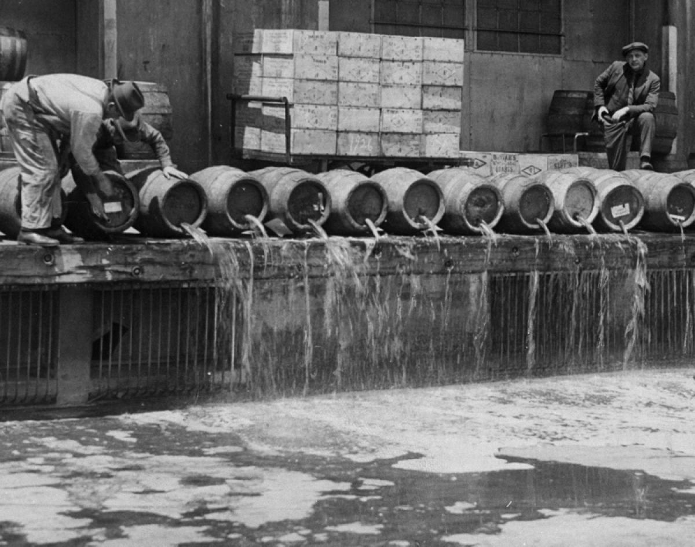
Prohibition
Many progressives believed alcohol explained many of society's problems.
Most of hard-earned money was spent on alcohol, which lead to drunkenness and physical abuse and sickness
The Temperance Movement emerged as they wanted to stop or moderate alcohol consumption
Mostly led by women and they pushed for prohibition-laws banning the manufacture, sale, and consumption of alcohol

Slide 15
Progressives Versus Big Business
Progressives agreed that big business needed regulation.
Some even believed they should break up big companies to restore competition
They wanted the government to regulate big companies and prevent them from abusing their power
Some progressives went even further and supported socialism which was the idea that the government should own and operate industry for the community.
Socialists believed in government ownership of business

Slide 16
Putting It All Together…
Progressives wanted to fix social problems that occurred during the industrial and imperialism era
Many good things came from it, including women’s suffrage, child labor laws, health and safety codes and even changes in democracy
These changes would only help further our interests as Americans and gave us all a sense of hope for the future
At this time many Americans feel unstoppable
With time, more progression occurs

